Slide 1

(C) 2013 Nantahala Outdoor Center Proprietary and Confidential
Notes:
----- Meeting Notes (2/15/13 11:38) -----
Really glad we put a compass in this logo.

Slide 2
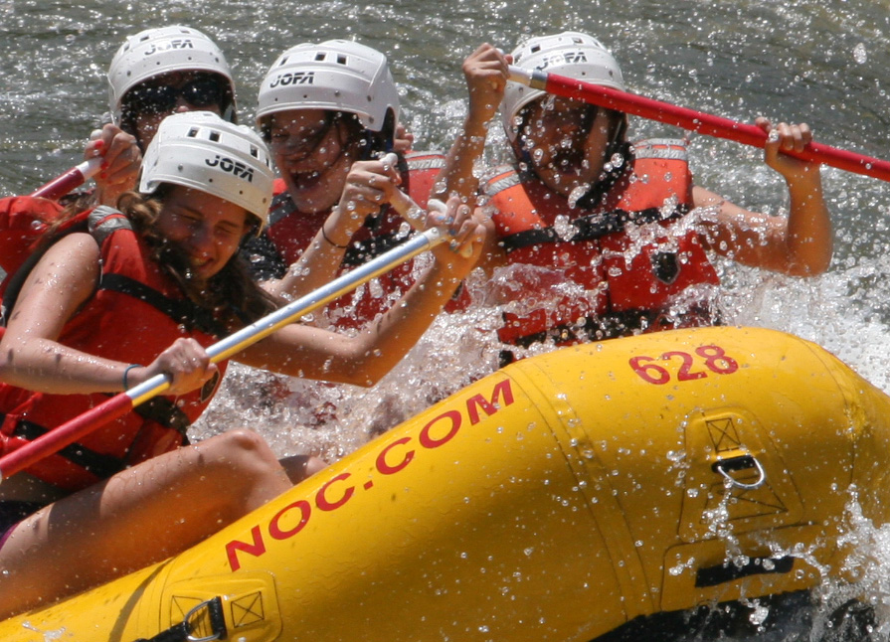
(C) 2013 Nantahala Outdoor Center Proprietary and Confidential
Notes:
Note that Girl Scouts can only raft Class III rivers, like Nantahala and French Broad.

Slide 3
Winners of the 2012 Outdoor Industry Association
Outdoor Inspiration Award
“One of the Best Outfitters on Earth”
—National Geographic Adventure
“Best Place to Learn”
—Outside magazine
Over 300,000 Fans on Facebook
(C) 2013 Nantahala Outdoor Center Proprietary and Confidential

Slide 4
Churches, camps, trade organizations, businesses and scout troops choose NOC because:
Established leader in our industry: we take more people whitewater rafting than any other company.
Reputation for excellence: over 22 Olympians and Olympic coaches have called NOC home, including two gold medalists.
We offer more programing than other outfitters: recreational, interpretive and certification-awarding.
(C) 2013 Nantahala Outdoor Center Proprietary and Confidential

Slide 5
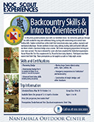
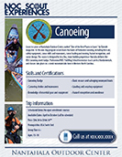
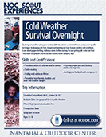
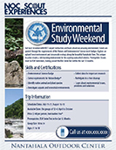
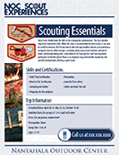

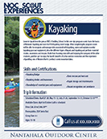
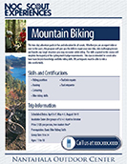
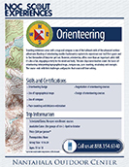
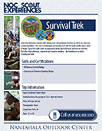
(C) 2013 Nantahala Outdoor Center Proprietary and Confidential

Slide 6
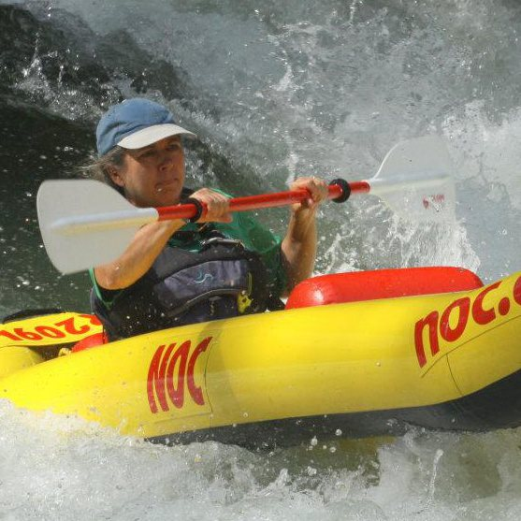
NOC Guide: Susan Coe
25-Year Troop Leader
Wrote Peaks to Piedmont Council’s Outdoor Skills Curriculum
(ALF) Adult Leadership Facilitator
Knows GSUSA Safety Checkpoints
(C) 2013 Nantahala Outdoor Center Proprietary and Confidential

Slide 7
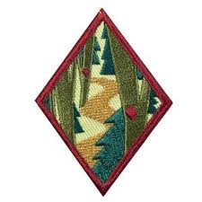
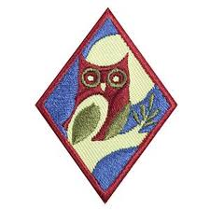
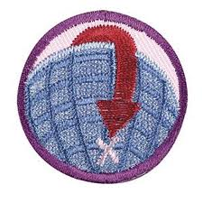
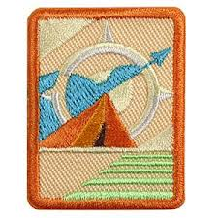
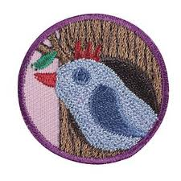
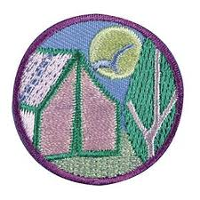
(C) 2013 Nantahala Outdoor Center Proprietary and Confidential

Slide 8
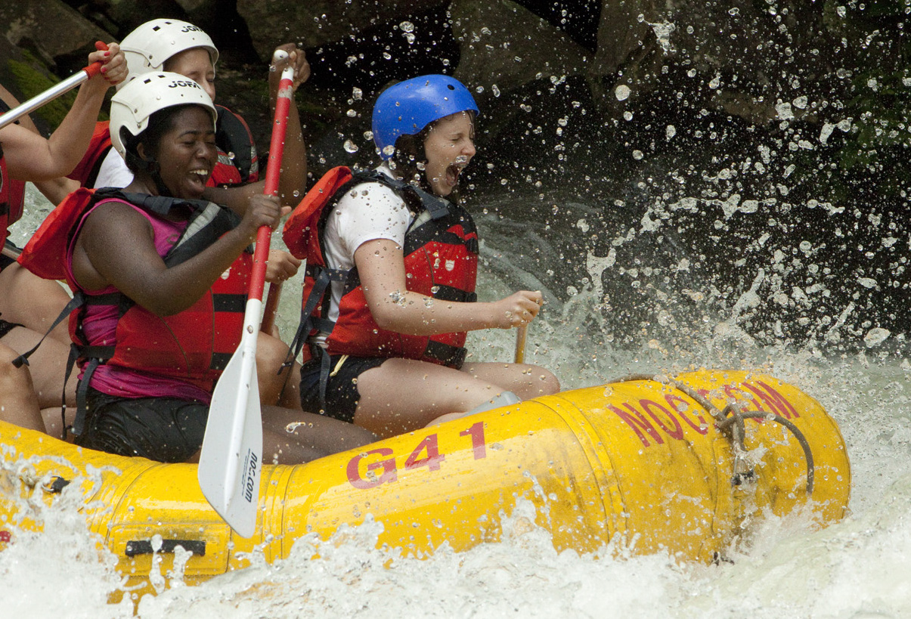
(C) 2013 Nantahala Outdoor Center Proprietary and Confidential

